Slide 1
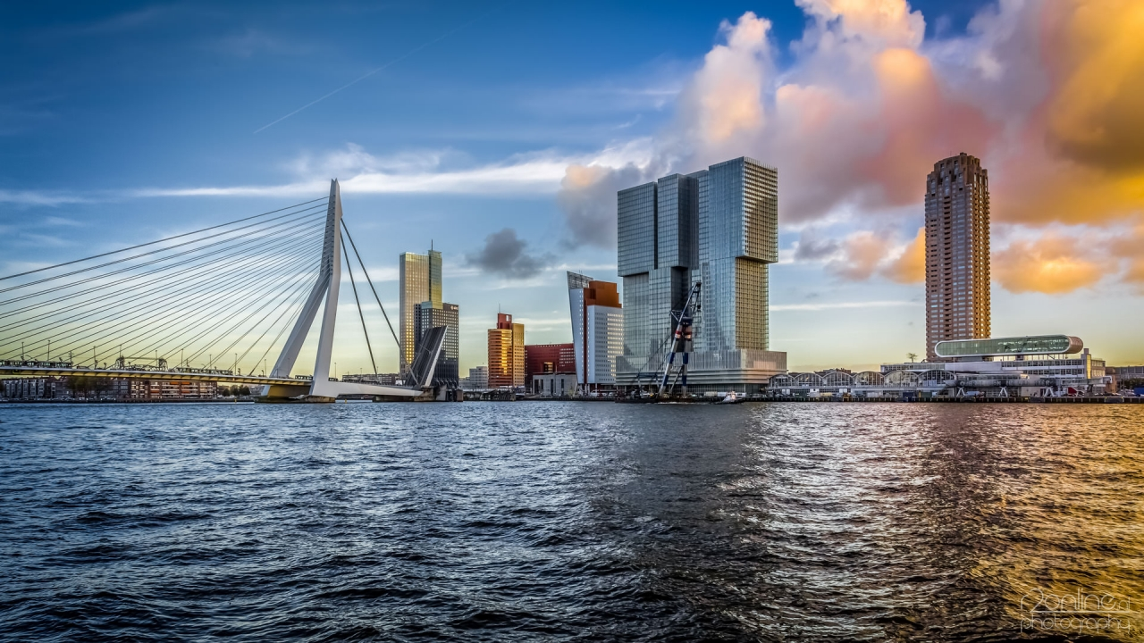
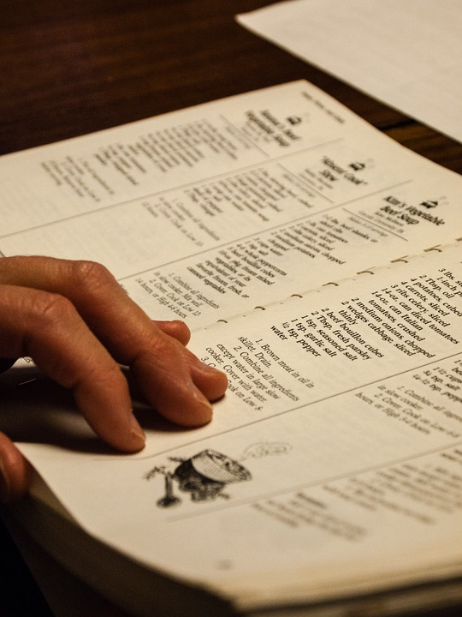
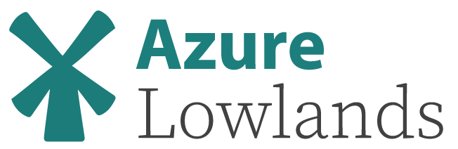

Azure Architecture Recipes
Eldert Grootenboer
Cloud Solution Architect

Slide 2








Gold Sponsors
Silver Sponsors
Community Sponsors

Slide 3



Eldert Grootenboer
@egrootenboer
Notes:
Cloud Solution Architect
Microsoft Azure MVP
SME IoT
International Speaker
Blogger
Global Integration Bootcamp
Azure IoT Community
Published Author
InfoQ
Boat enthusiast

Slide 4
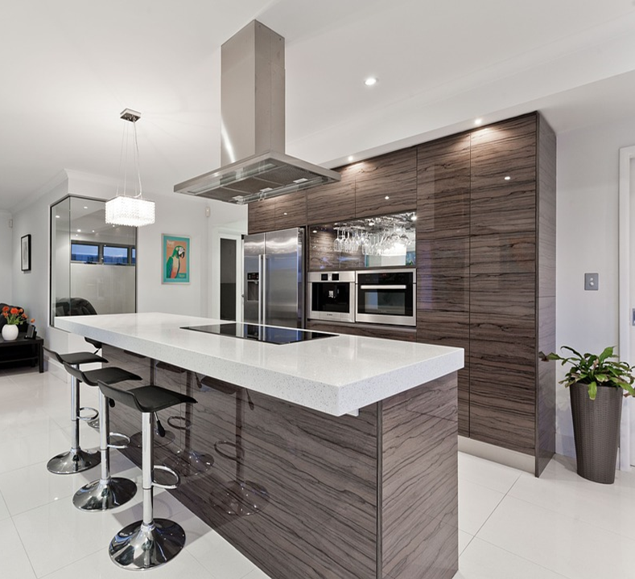
Setting up…
Notes:
2 - 43
What to expect:
Architecture
No Demos

Slide 5
What is the right size of
servers for my business needs?
How do I deploy new code to my server?
What media should I
use to keep backup?
What happens in case of
server hardware failure?
Which packages should be on my server?
What size of servers
should I buy?
Who monitors
my App?
How often should I backup my server?
How can I scale my app?
How can I increase server utilization?
Who has physical
access to my servers?
Which OS should I use?
Do I need secondary network connection?
Are my server in a
secure location?
What happens if the
power goes out?
Who monitors
my Servers?
Do I need a UPS?
What storage I need to use?
How many servers
do I need?
How can I dynamically configure my app?
It takes how long to provision a new server?
How often should
I patch my servers?
On-Premises

Slide 6
What is the right size of servers for my business needs?
How can I increase server utilization?
How many servers do I need?
How can I scale my app?
How often should I patch my servers?
How do I deploy new code to my server?
How often should I backup my server?
Which OS should I use?
Which packages should be on my server?
Who monitors my App?
On-Premises
IaaS

Slide 7
What is the right tier for my business needs?
How can I increase compute utilization?
How many instances do I need?
How can I scale my app?
On-Premises
IaaS
PaaS

Slide 8
How do I architect my app?
Serverless, the platform for next gen apps
On-Premises
IaaS
PaaS
Serverless
Notes:
Scalability
Pricing pay as you go
Just bring application
From paas is where the value is

Slide 9

Choosing the right components…
Notes:
5 - 40

Slide 10
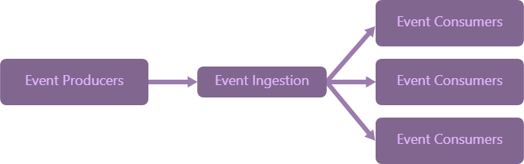
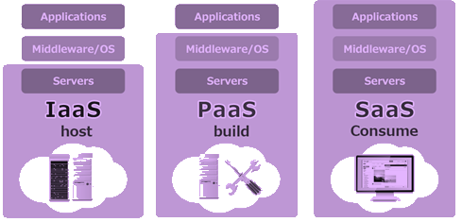

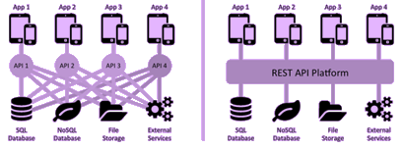

Architecture Principles
Notes:
SaaS before paas before iaas
Event driven
Middleware, no spaghetti architecture
Scalable
Security and governance

Slide 11



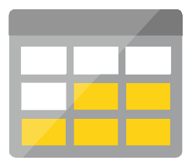
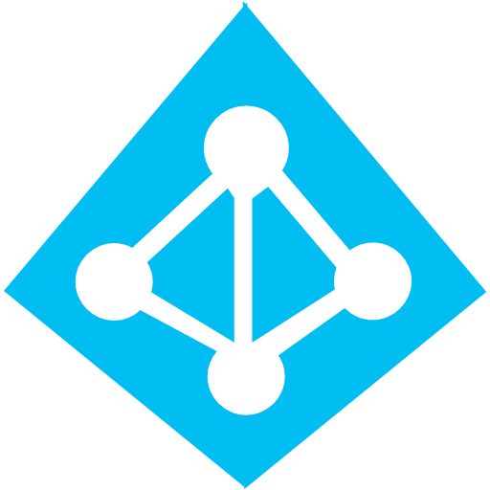



Azure Components
Development
Platform
IDE support
Event Grid
Logic Apps
Functions
Manage all events that can trigger code or logic
Design workflows and orchestrate processes
Execute your code based on events you specify
Integrated DevOps
Local Development
Monitoring
Database
Storage
Security
IoT
Analytics
Intelligence
Visual Debug History
Notes:
Service Fabric Mesh
API Management Consumption tier
Azure Container Instances

Slide 12
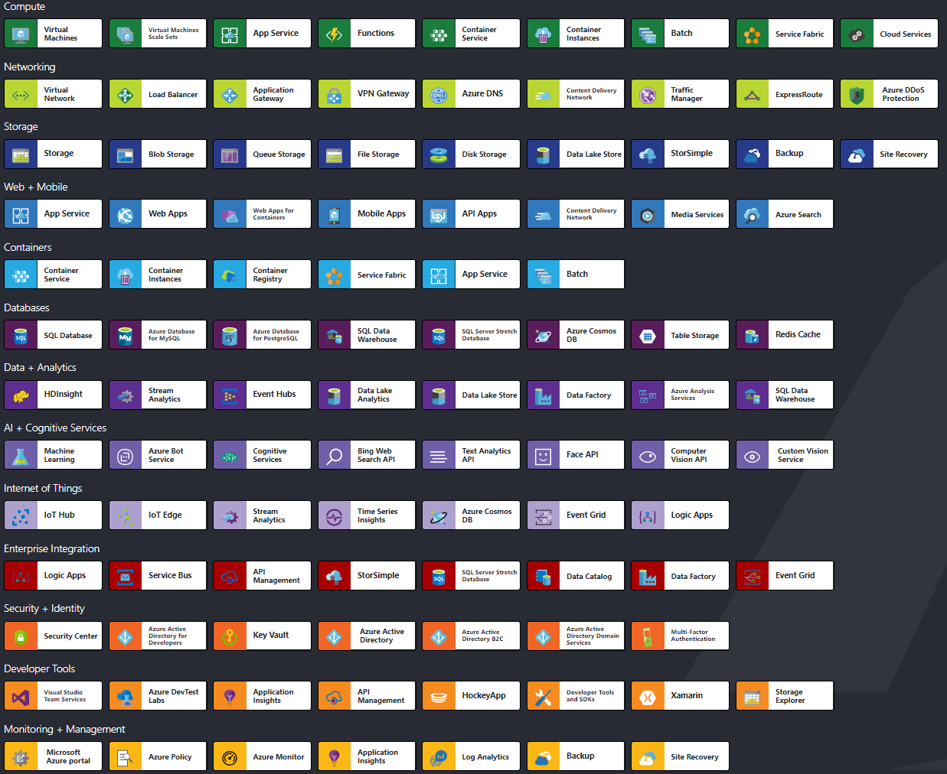
Building Blocks

Slide 13



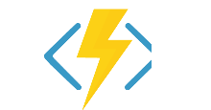
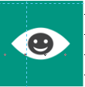


Better Together
Limitless Possibilities

Slide 14

Let’s get cooking!
Notes:
10 - 35

Slide 15
Let’s get cooking
Customer stories
Client wishes
Proposed solution
Alternatives

Slide 16
Fan Out
Routing
Guaranteed delivery
Single or multiple destinations

Slide 17




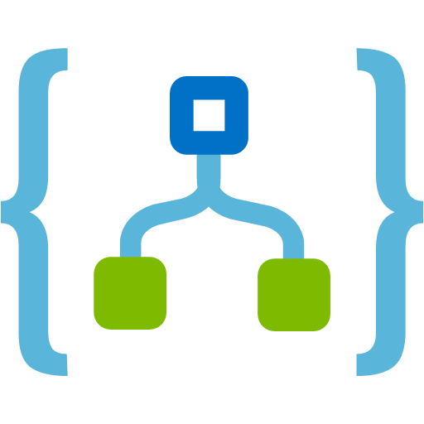

Fan Out

Slide 18

Fan Out
Service Bus Topics
Enterprise messaging
Advanced filtering
Allows batching, duplicate detection, sessions, etc.
Event Grid
Event driven
High throughput
Serverless

Slide 19
Microservices
Scalability
Insights
Programming language

Slide 20



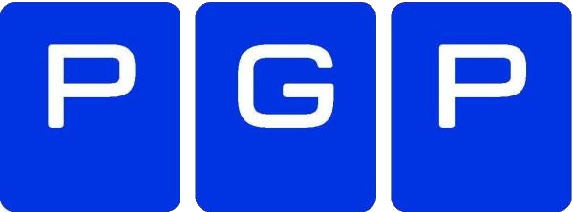
Microservices
Notes:
Skip next slides if low on time

Slide 21
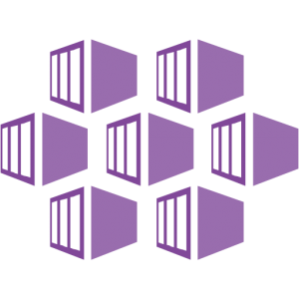
Microservices
Azure Functions
Serverless
Event driven
Scalable
Azure Kubernetes Service
Container based
Full language stack available
Full control

Slide 22
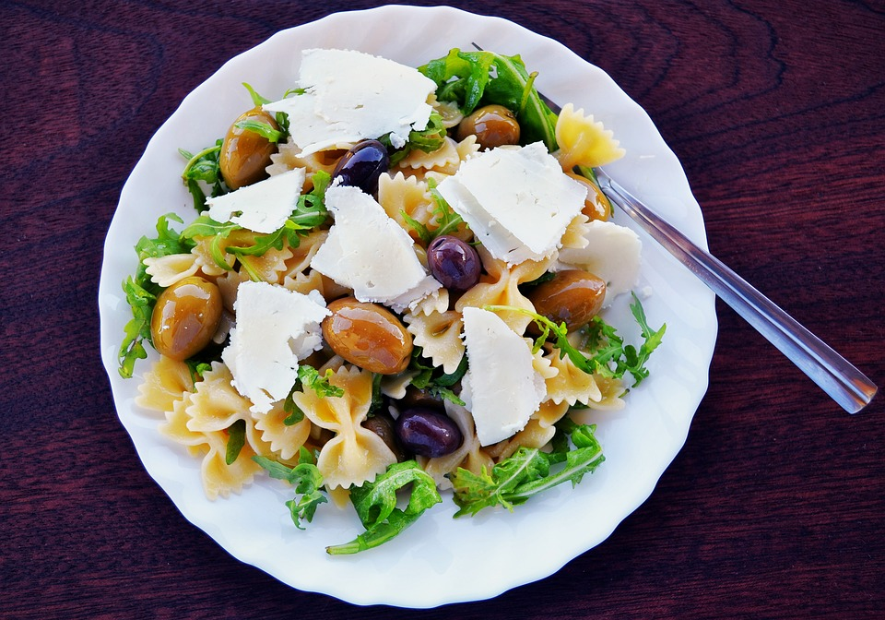
Cloud native?
Notes:
20 - 25

Slide 23
Ecommerce
Scalable
Around the clock
Peak loads

Slide 24





Ecommerce
Notes:
DNS-based traffic load balancer
Global
Traffic-routing method
Health of the endpoints

Slide 25

Ecommerce
Traffic Manager
DNS level traffic distribution
Load balancing and prioritization
Geo redirection
Front Door
SSL offload and application acceleration at the edge
Global HTTP load balancing with instant failover
Application firewall and DDoS protection

Slide 26
Workflow
Easy but powerful design
SaaS and PaaS connectors
Monitoring and logging

Slide 27




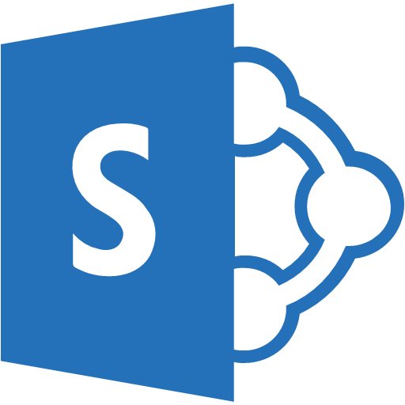
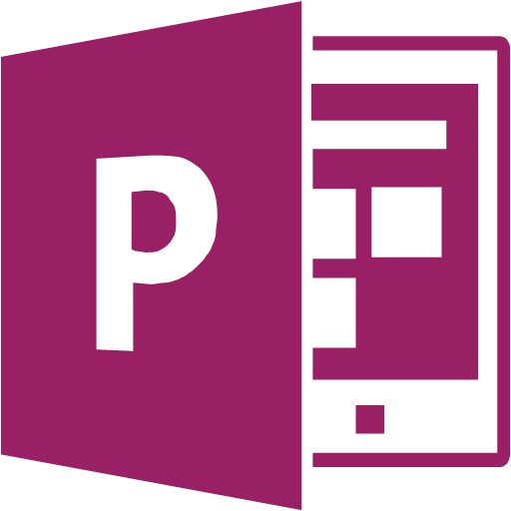
Workflow

Slide 28
Workflow
Logic Apps
Over 200 connectors
Visual designer
Rich monitoring and management
Durable Functions
Execute code in several languages
Portable runtime
Serverless or App Service Plan

Slide 29
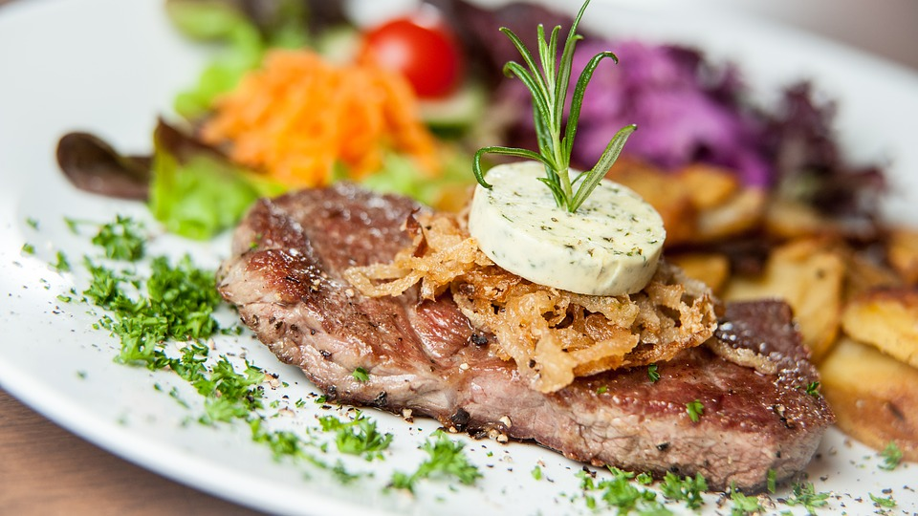
DevOps?
Notes:
30 - 15

Slide 30
Eventing
No polling
Scalability
Stability

Slide 31
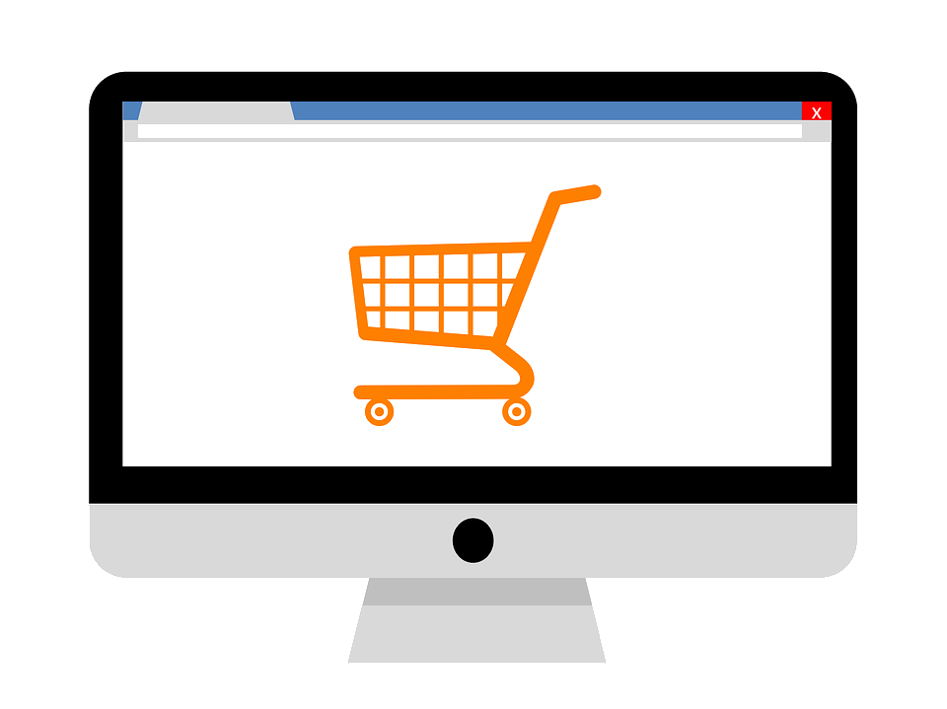

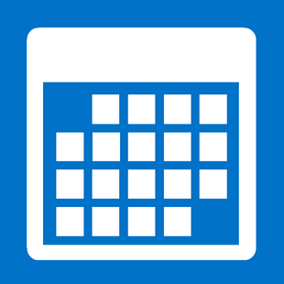


Eventing

Slide 32
Eventing
Event Grid
Event driven
Auto-retry, dead lettering
Cross cloud
Event Hubs
Streaming, real-time and batch processing
Kafka support
Capture and auto-inflate

Slide 33
Service Repository
Abstract backend services
Near real-time insights
Smarter services

Slide 34
Service Repository
Notes:
Repository of services
Discovery
Security
Smarter services

Slide 35
Service Repository
API Management
Policies
Security
Developer portal
Azure Functions
Routing
Lightweight
Cost effective

Slide 36

Almost done…
Notes:
40 - 5

Slide 37
Key Takeaways
Cloud computing
Focus on value
Cost Efficient
Keep pricing in mind when choosing components
Better Together
Combine services to create powerful scenarios

Slide 38



Thank You
@egrootenboer
eldert@eldert.net
https://blog.eldert.net/

Slide 39
Track 1
15:35 – 16:20
Skynet Is Talking - Microsoft Bot Framework
Kris van der Mast
Track 2
15:35 – 16:20
Enter The Matrix: Securing Azure's Assets
Mike Martin

